Slide 1
Physics 101: Mechanics Lecture 7
Physics

Slide 2
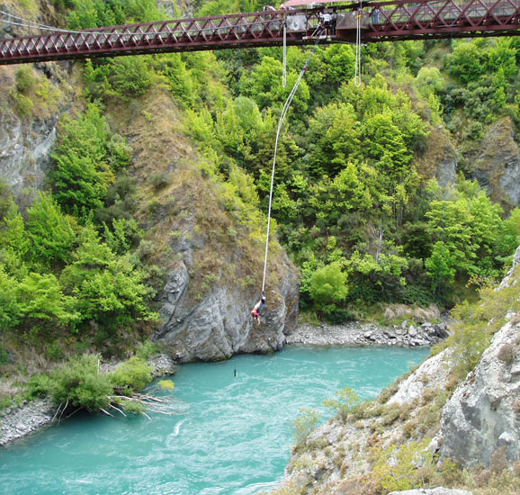
Potential Energy and
Energy Conservation
Work
Kinetic Energy
Work-Kinetic Energy Theorem
Gravitational Potential Energy
Elastic Potential Energy
Work-Energy Theorem
Conservative and
Non-conservative Forces
Conservation of Energy

Slide 3

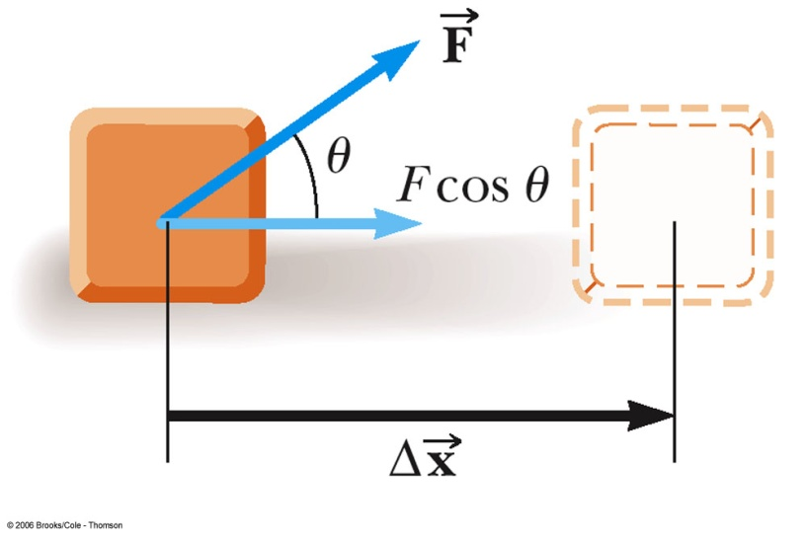

Definition of Work W
The work, W, done by a constant force on an object is defined as the product of the component of the force along the direction of displacement and the magnitude of the displacement
  F is the magnitude of the force
  Δ x is the magnitude of the
  object’s displacement
  θ is the angle between

Slide 4

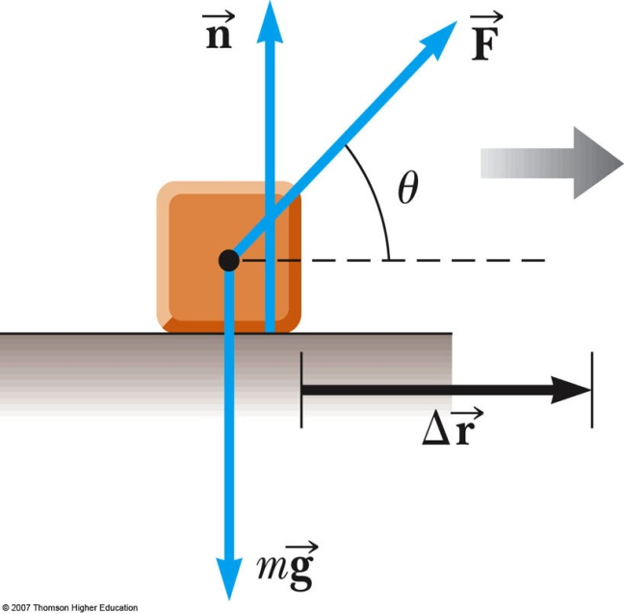
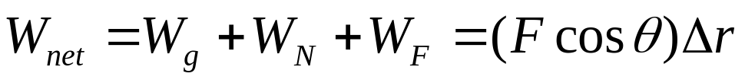
Work Done by Multiple Forces
If more than one force acts on an object, then the total work is equal to the algebraic sum of the work done by the individual forces
  Remember work is a scalar, so
  this is the algebraic sum

Slide 5
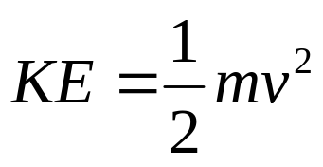
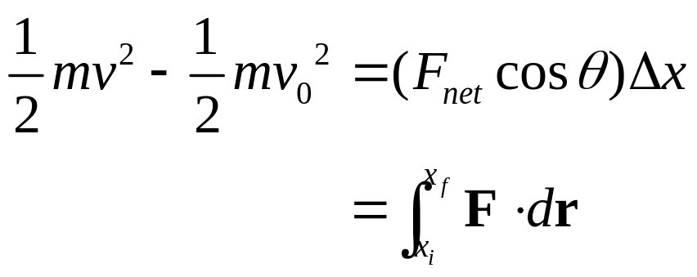

Kinetic Energy and Work
Kinetic energy associated with the motion of an object
Scalar quantity with the same unit as work
Work is related to kinetic energy
Units: N-m or J

Slide 6
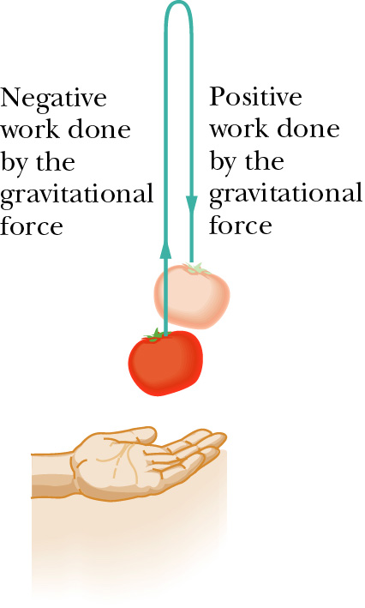


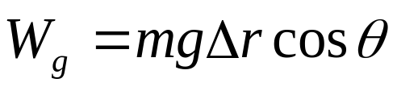
Work done by a Gravitational Force
Gravitational Force
  Magnitude: mg
  Direction: downwards to the Earth’s center
Work done by Gravitational Force

Slide 7
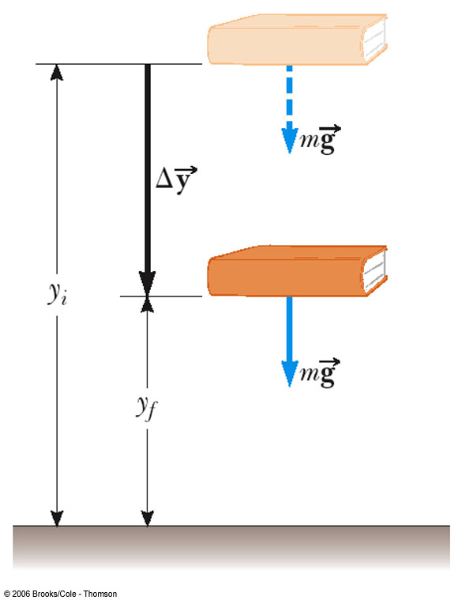

Potential Energy
Potential energy is associated with the position of the object
Gravitational Potential Energy is the energy associated with the relative position of an object in space near the Earth’s surface
The gravitational potential energy
  m is the mass of an object
  g is the acceleration of gravity
  y is the vertical position of the mass relative the surface of the Earth
  SI unit: joule (J)

Slide 8
Reference Levels
A location where the gravitational potential energy is zero must be chosen for each problem
  The choice is arbitrary since the change in the potential energy is the important quantity
  Choose a convenient location for the zero reference height
    often the Earth’s surface
    may be some other point suggested by the problem
  Once the position is chosen, it must remain fixed for the entire problem

Slide 9
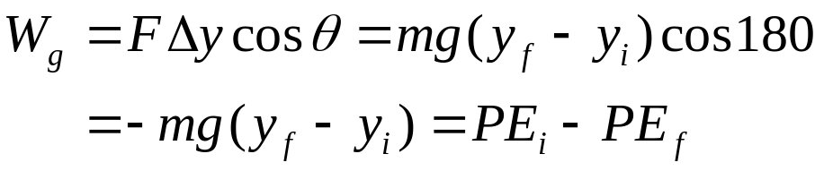

Work and Gravitational
Potential Energy
PE = mgy
Units of Potential Energy are the same as those of Work and Kinetic Energy

Slide 10


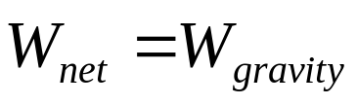
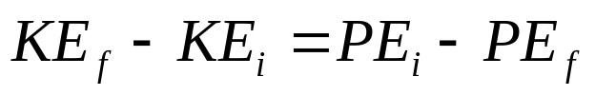
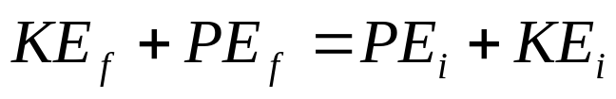
Extended Work-Energy Theorem
The work-energy theorem can be extended to include potential energy:
If we only have gravitational force, then
The sum of the kinetic energy and the gravitational potential energy remains constant at all time and hence is a conserved quantity

Slide 11

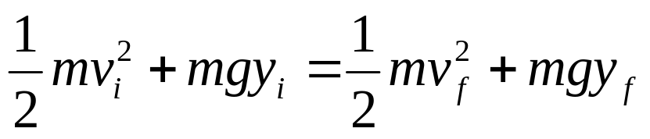
Extended Work-Energy Theorem
We denote the total mechanical energy by
Since
The total mechanical energy is conserved and remains the same at all times

Slide 12
Problem-Solving Strategy
Define the system
Select the location of zero gravitational potential energy
  Do not change this location while solving the problem
Identify two points the object of interest moves between
  One point should be where information is given
  The other point should be where you want to find out something

Slide 13
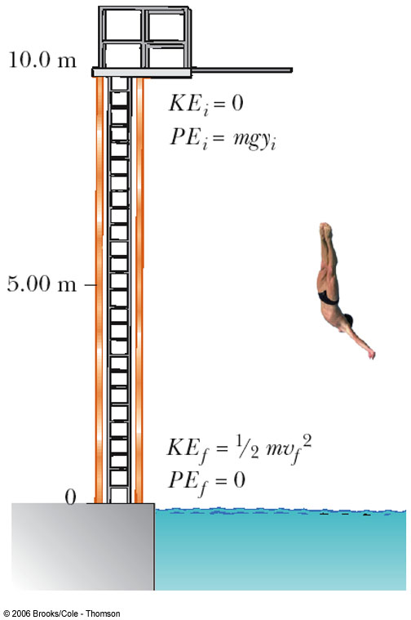
Platform Diver
A diver of mass m drops from a board 10.0 m above the water’s surface. Neglect air resistance.
(a) Find is speed 5.0 m above the water surface
(b) Find his speed as he hits the water

Slide 14
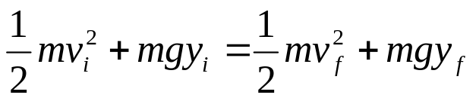
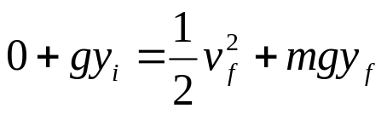
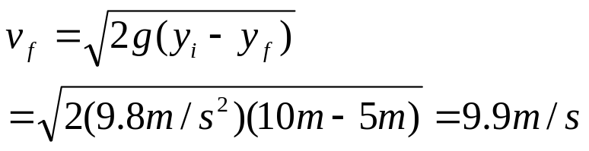
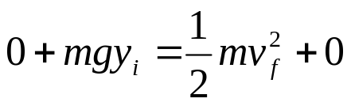

Platform Diver
(a) Find his speed 5.0 m above the water surface
(b) Find his speed as he hits the water

Slide 15
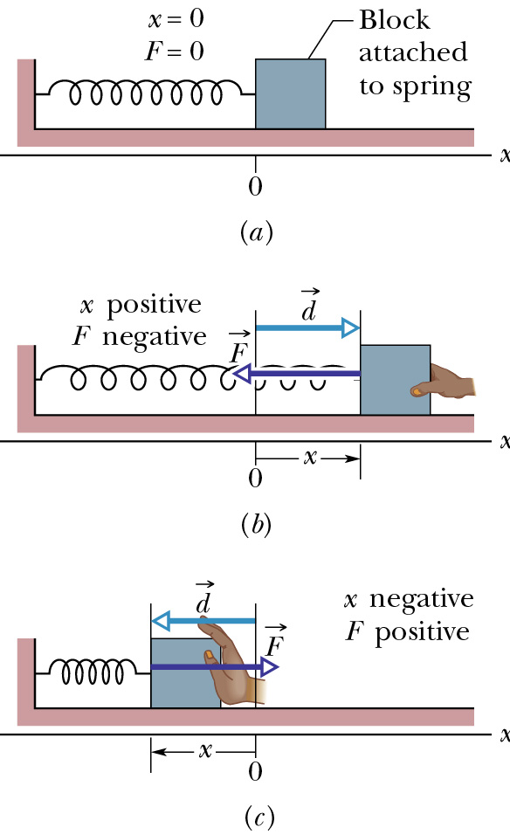
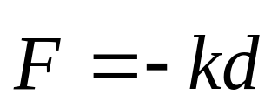
Spring Force
Involves the spring constant, k
Hooke’s Law gives the force
  F is in the opposite direction of displacement d, always back towards the equilibrium point.
  k depends on how the spring was formed, the material it is made from, thickness of the wire, etc. Unit: N/m.

Slide 16
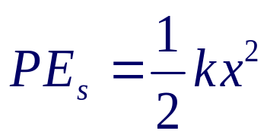
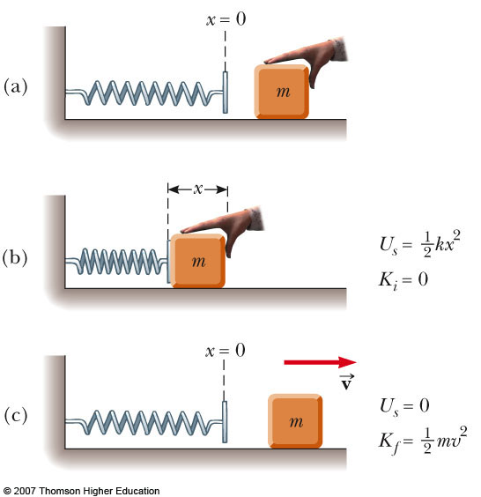
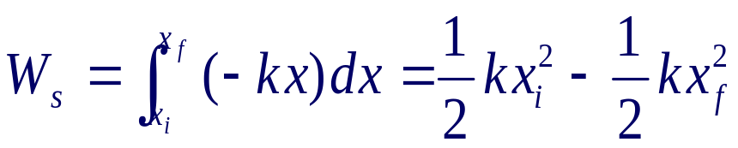

Potential Energy in a Spring
Elastic Potential Energy:
  SI unit: Joule (J)
  related to the work required to compress a spring from its equilibrium position to some final, arbitrary, position x
Work done by the spring

Slide 17

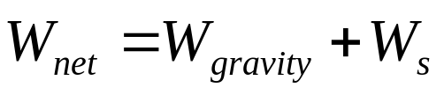
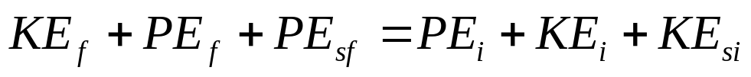
Extended Work-Energy Theorem
The work-energy theorem can be extended to include potential energy:
If we include gravitational force and spring force, then

Slide 18

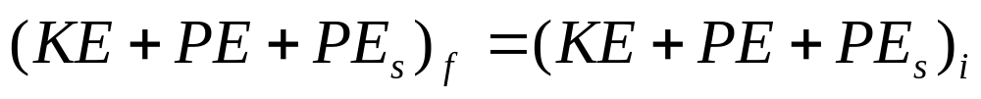
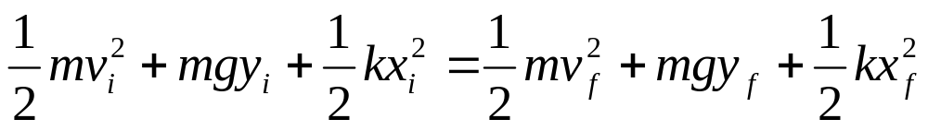
Extended Work-Energy Theorem
We denote the total mechanical energy by
Since
The total mechanical energy is conserved and remains the same at all times

Slide 19
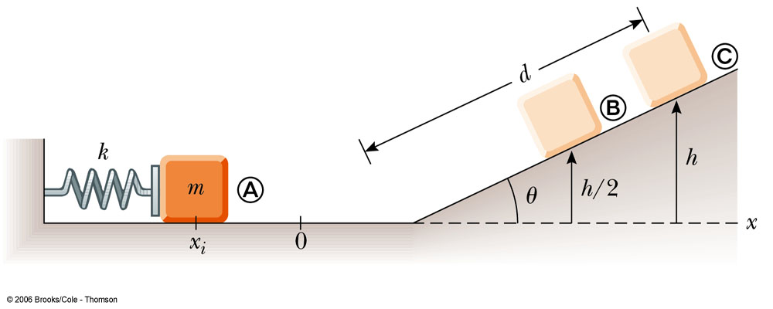
A block projected up a incline
A 0.5-kg block rests on a horizontal, frictionless surface. The block is pressed back against a spring having a constant of k = 625 N/m, compressing the spring by 10.0 cm to point A. Then the block is released.
(a) Find the maximum distance d the block travels up the frictionless incline if θ = 30°.
(b) How fast is the block going when halfway to its maximum height?

Slide 20


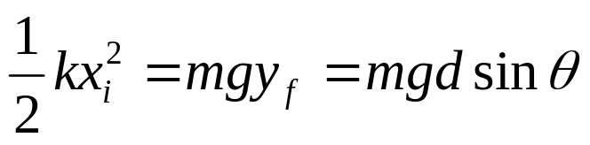
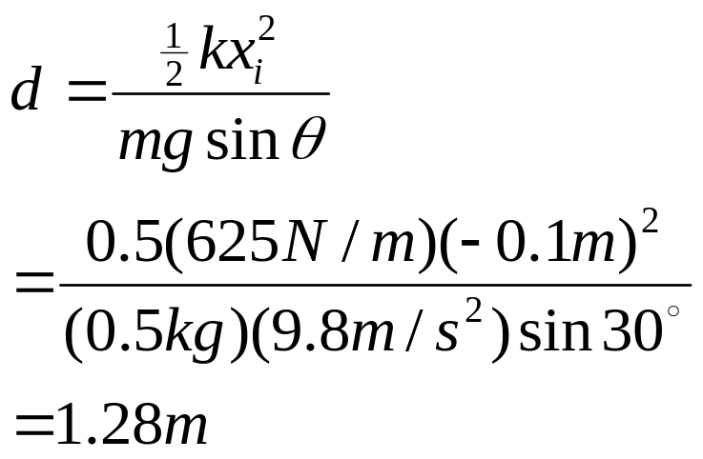
A block projected up a incline
Point A (initial state):
Point B (final state):

Slide 21

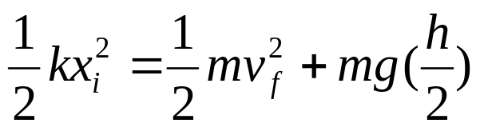
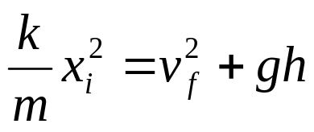
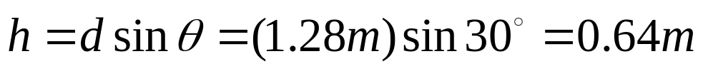
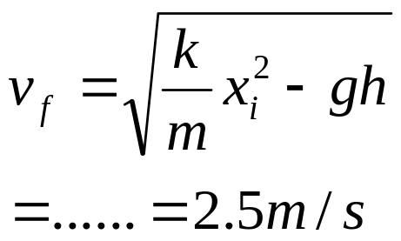
A block projected up a incline
Point A (initial state):
Point B (final state):

Slide 22
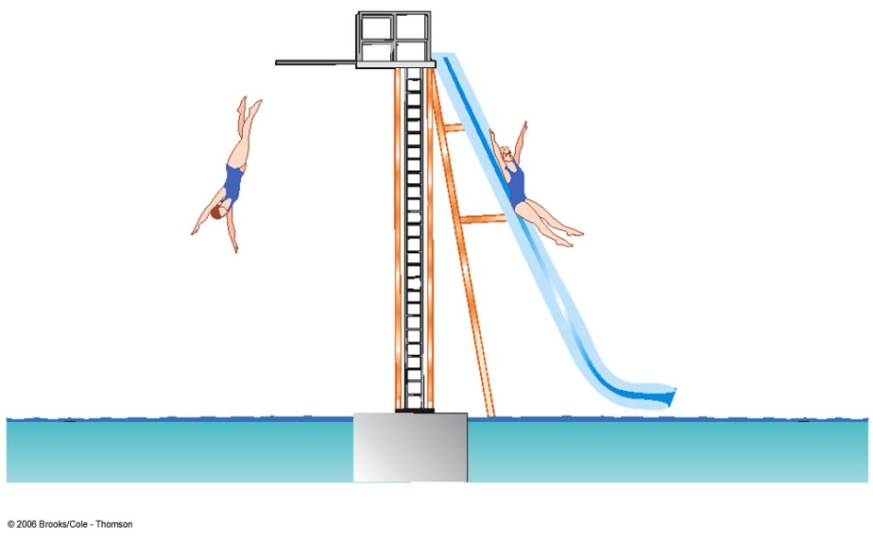
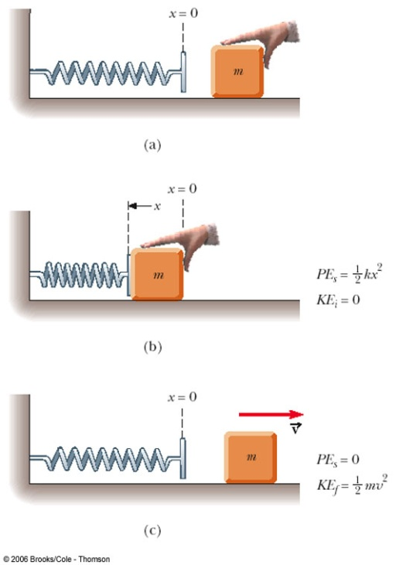
Types of Forces
Conservative forces
  Work and energy associated with the force can be recovered
  Examples: Gravity, Spring Force, EM forces
Nonconservative forces
  The forces are generally dissipative and work done against it cannot easily be recovered
  Examples: Kinetic friction, air drag forces, normal forces, tension forces, applied forces …

Slide 23

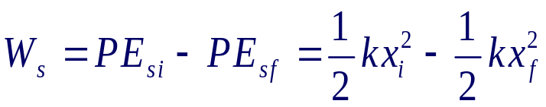
Conservative Forces
A force is conservative if the work it does on an object moving between two points is independent of the path the objects take between the points
  The work depends only upon the initial and final positions of the object
  Any conservative force can have a potential energy function associated with it
  Work done by gravity
  Work done by spring force

Slide 24
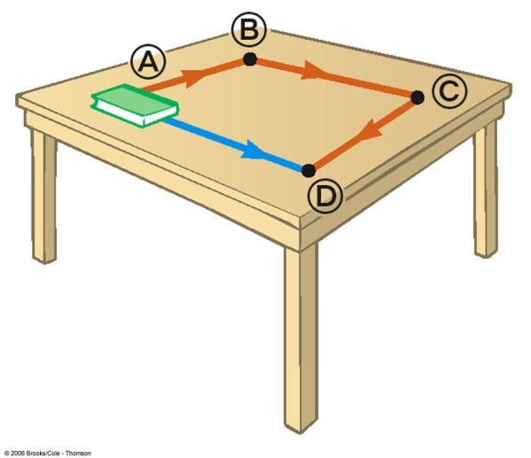
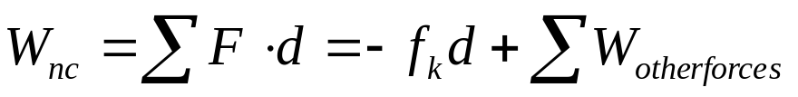
Nonconservative Forces
A force is nonconservative if the work it does on an object depends on the path taken by the object between its final and starting points.
  The work depends upon the movement path
  For a non-conservative force, potential energy can NOT be defined
  Work done by a nonconservative force
  It is generally dissipative. The dispersal
  of energy takes the form of heat or sound

Slide 25
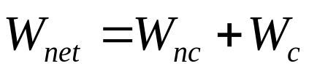


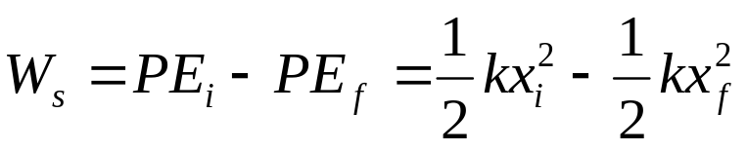
Extended Work-Energy Theorem
The work-energy theorem can be written as:
  W_{nc} represents the work done by nonconservative forces
  W_{c} represents the work done by conservative forces
Any work done by conservative forces can be accounted for by changes in potential energy
  Gravity work
  Spring force work

Slide 26
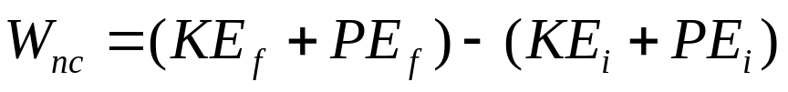
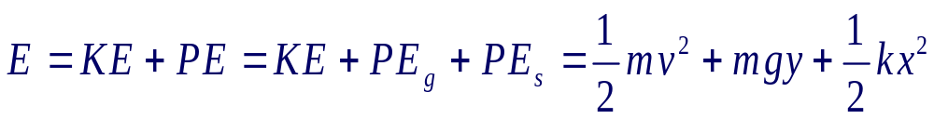
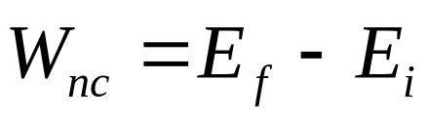
Extended Work-Energy Theorem
Any work done by conservative forces can be accounted for by changes in potential energy
Mechanical energy includes kinetic and potential energy

Slide 27
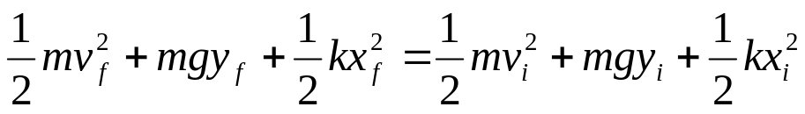

Problem-Solving Strategy
Define the system to see if it includes non-conservative forces (especially friction, drag force …)
Without non-conservative forces
With non-conservative forces
Select the location of zero potential energy
  Do not change this location while solving the problem
Identify two points the object of interest moves between
  One point should be where information is given
  The other point should be where you want to find out something

Slide 28
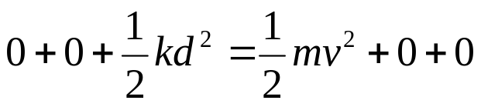
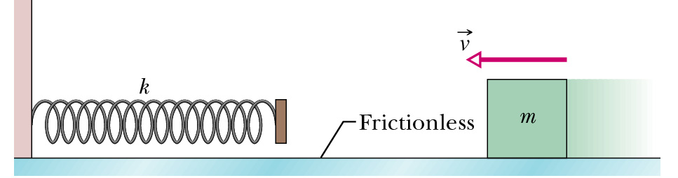

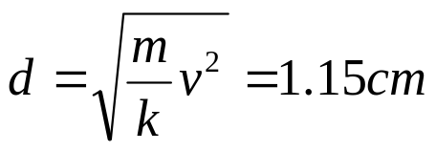
Conservation of Mechanical Energy
A block of mass m = 0.40 kg slides across a horizontal frictionless counter with a speed of v = 0.50 m/s. It runs into and compresses a spring of spring constant k = 750 N/m. When the block is momentarily stopped by the spring, by what distance d is the spring compressed?

Slide 29
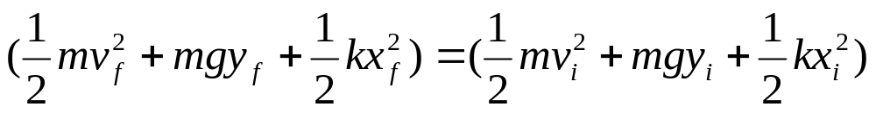





Changes in Mechanical Energy for conservative forces
A 3-kg crate slides down a ramp. The ramp is 1 m in length and inclined at an angle of 30° as shown. The crate starts from rest at the top. The surface friction can be negligible. Use energy methods to determine the speed of the crate at the bottom of the ramp.

Slide 30




Changes in Mechanical Energy for Non-conservative forces
A 3-kg crate slides down a ramp. The ramp is 1 m in length and inclined at an angle of 30° as shown. The crate starts from rest at the top. The surface in contact have a coefficient of kinetic friction of 0.15. Use energy methods to determine the speed of the crate at the bottom of the ramp.
N
fk

Slide 31





Changes in Mechanical Energy for Non-conservative forces
A 3-kg crate slides down a ramp. The ramp is 1 m in length and inclined at an angle of 30° as shown. The crate starts from rest at the top. The surface in contact have a coefficient of kinetic friction of 0.15. How far does the crate slide on the horizontal floor if it continues to experience a friction force.

Slide 32



Block-Spring Collision
A block having a mass of 0.8 kg is given an initial velocity v_{A} = 1.2 m/s to the right and collides with a spring whose mass is negligible and whose force constant is k = 50 N/m as shown in figure. Assuming the surface to be frictionless, calculate the maximum compression of the spring after the collision.

Slide 33





Block-Spring Collision
A block having a mass of 0.8 kg is given an initial velocity v_{A} = 1.2 m/s to the right and collides with a spring whose mass is negligible and whose force constant is k = 50 N/m as shown in figure. Suppose a constant force of kinetic friction acts between the block and the surface, with µ_{k} = 0.5, what is the maximum compression x_{c} in the spring.

Slide 34
Energy Review
Kinetic Energy
  Associated with movement of members of a system
Potential Energy
  Determined by the configuration of the system
  Gravitational and Elastic
Internal Energy
  Related to the temperature of the system

Slide 35





Conservation of Energy
Energy is conserved
  This means that energy cannot be created nor destroyed
  If the total amount of energy in a system changes, it can only be due to the fact that energy has crossed the boundary of the system by some method of energy transfer

Slide 36
Ways to Transfer Energy
Into or Out of A System
Work – transfers by applying a force and causing a displacement of the point of application of the force
Mechanical Waves – allow a disturbance to propagate through a medium
Heat – is driven by a temperature difference between two regions in space
Matter Transfer – matter physically crosses the boundary of the system, carrying energy with it
Electrical Transmission – transfer is by electric current
Electromagnetic Radiation – energy is transferred by electromagnetic waves

Slide 37







Connected Blocks in Motion
Two blocks are connected by a light string that passes over a frictionless pulley. The block of mass m₁ lies on a horizontal surface and is connected to a spring of force constant k. The system is released from rest when the spring is unstretched. If the hanging block of mass m₂ falls a distance h before coming to rest, calculate the coefficient of kinetic friction between the block of mass m₁ and the surface.

Slide 38

Power
Work does not depend on time interval
The rate at which energy is transferred is important in the design and use of practical device
The time rate of energy transfer is called power
The average power is given by
  when the method of energy transfer is work

Slide 39



Instantaneous Power
Power is the time rate of energy transfer. Power is valid for any means of energy transfer
Other expression
A more general definition of instantaneous power

Slide 40
Units of Power
The SI unit of power is called the watt
  1 watt = 1 joule / second = 1 kg . m² / s³
A unit of power in the US Customary system is horsepower
  1 hp = 550 ft . lb/s = 746 W
Units of power can also be used to express units of work or energy
  1 kWh = (1000 W)(3600 s) = 3.6 x10⁶ J

Slide 41






Power Delivered by an Elevator Motor
A 1000-kg elevator carries a maximum load of 800 kg. A constant frictional force of 4000 N retards its motion upward. What minimum power must the motor deliver to lift the fully loaded elevator at a constant speed of 3 m/s?

Slide 42


